Slide 1
This is the start menu.If the start button is pressed, then the main game window is launched. If the quit button is pressed then the window is closed
Petru-Stefan Salanta
#2016
Welcome to Space Hunter!
Start
Quit

Slide 2
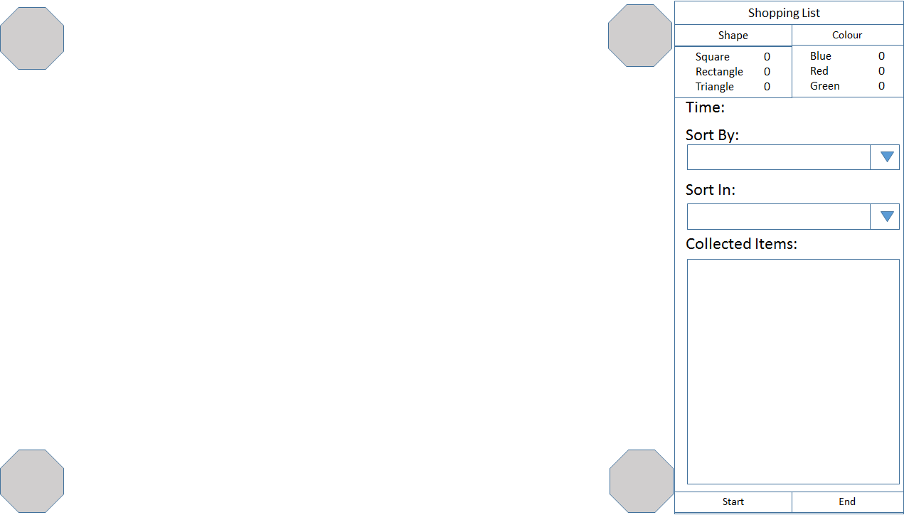
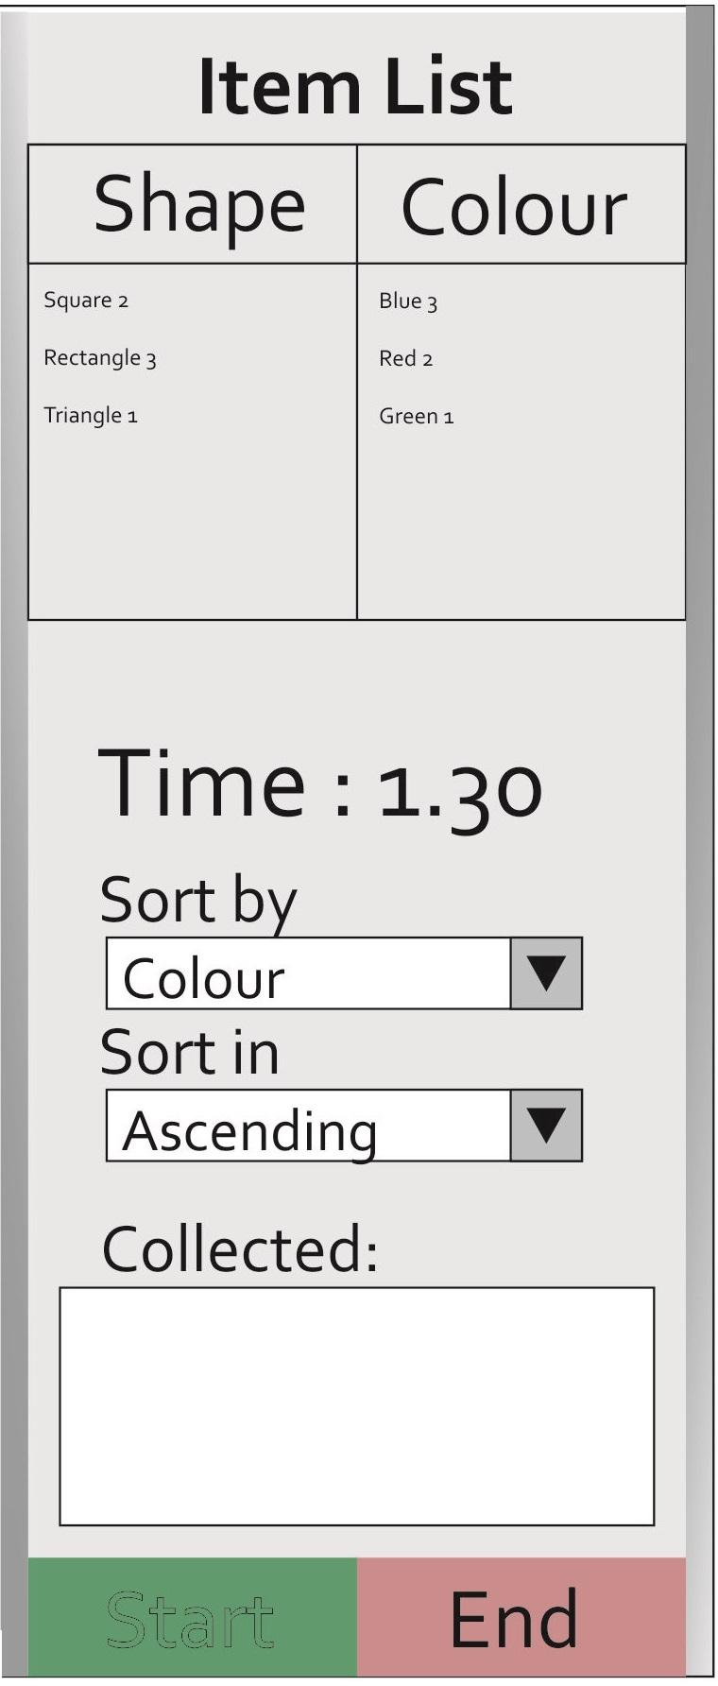
Initial game screen before start has been pressed and before all required inputs have been filled. The octagons are spawn locations and the user indicates which one to spawn at by clicking on the desired one. Each time for example square or blue is clicked on by the user, the amount of items of that type to be found by the rocket is incremented by one. The time field will use a textbox and the Sort fields will use dropdown boxes that reduce typing errors and inform the user how the list can be sorted. Finally a larger box will be used to store the collected items. Each input has a clear title above to show where the information needs to be entered by the user. By George Coleman

Slide 3
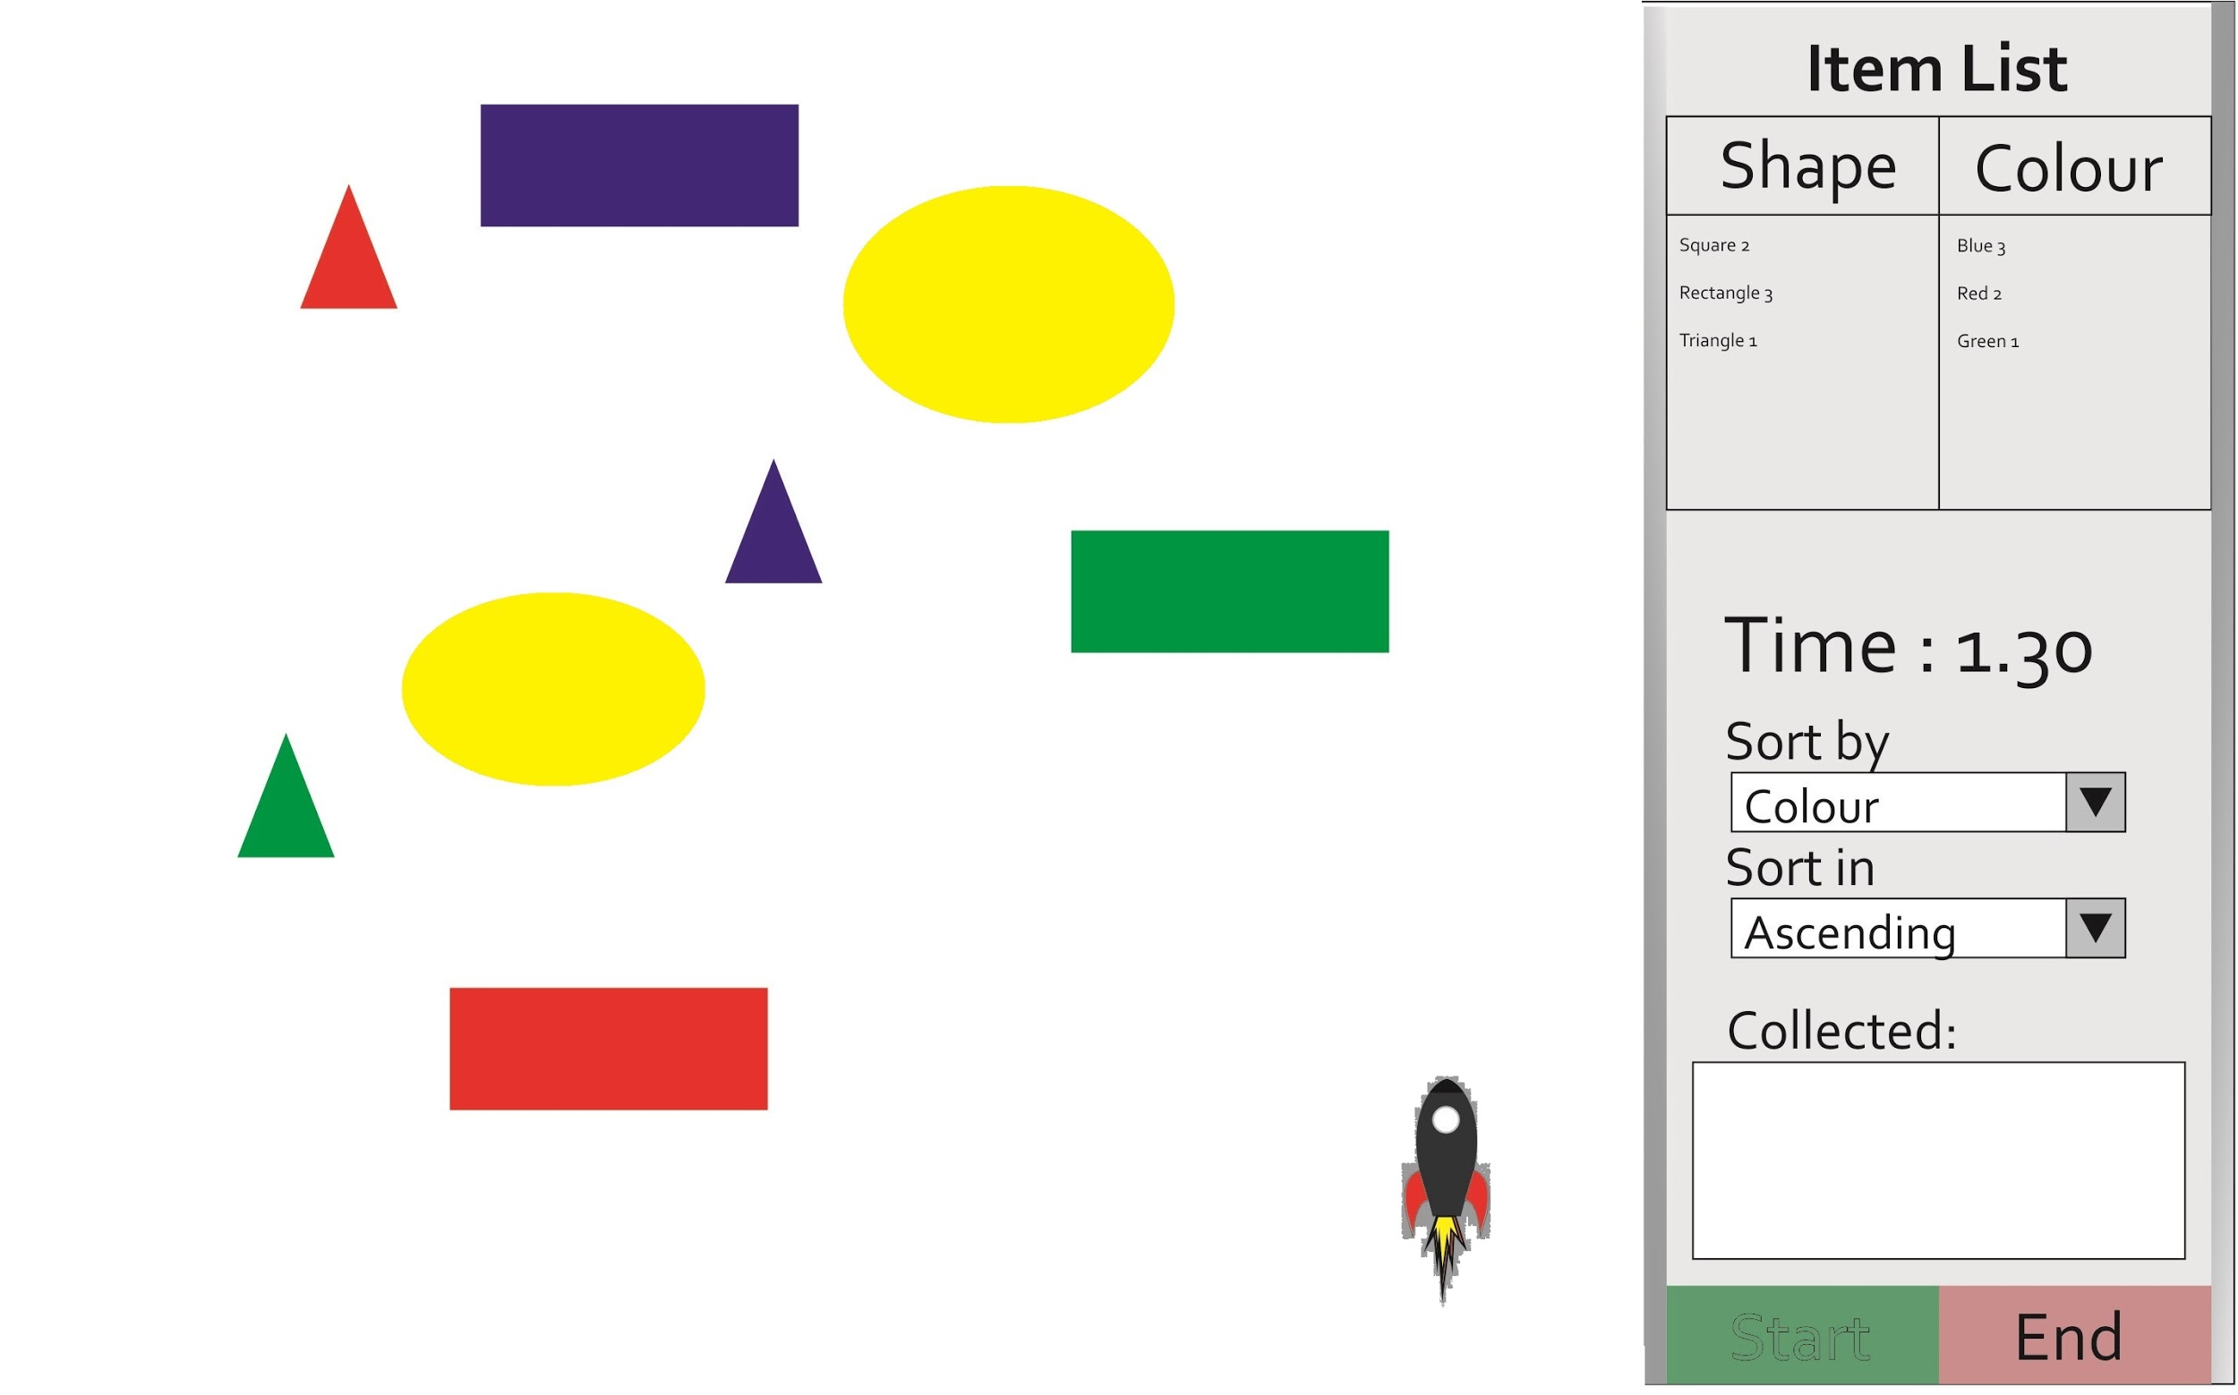
At this point, everything is spawned in. This means the sprites are generated in for the rocket ship, objects and obstacles.
-Sam Rockett

Slide 4

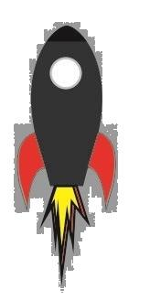
Rocket begins movement towards objects. Avoiding the circular objects. However, when the rocket hits a desired object, the object disappears from the map and appears in the collected items box.
Petru-Stefan Salanta

Slide 5

This shows the screen when the searching algorithm is complete. Thus all objects on the list have been found.
Alternatively the game can end if the time runs out. Thus the user must now press the sort button which will launch a new window.
SORT
Tim Howard

